Slide 1

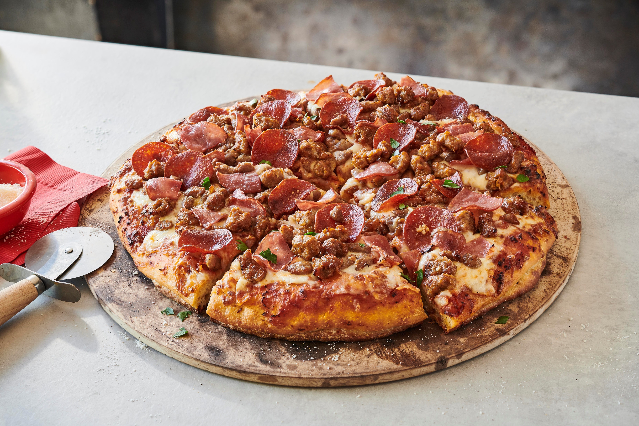
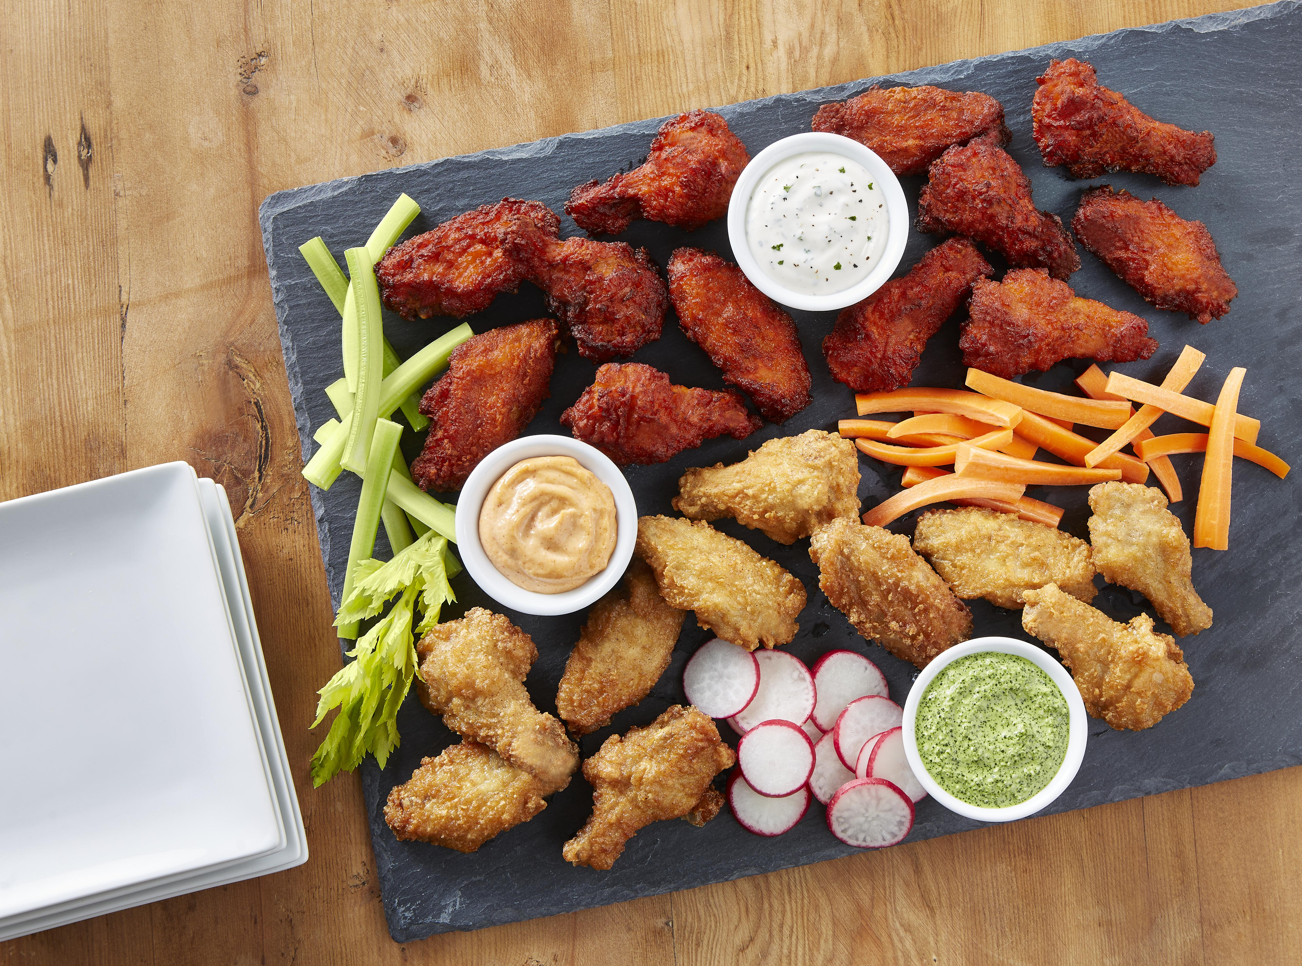
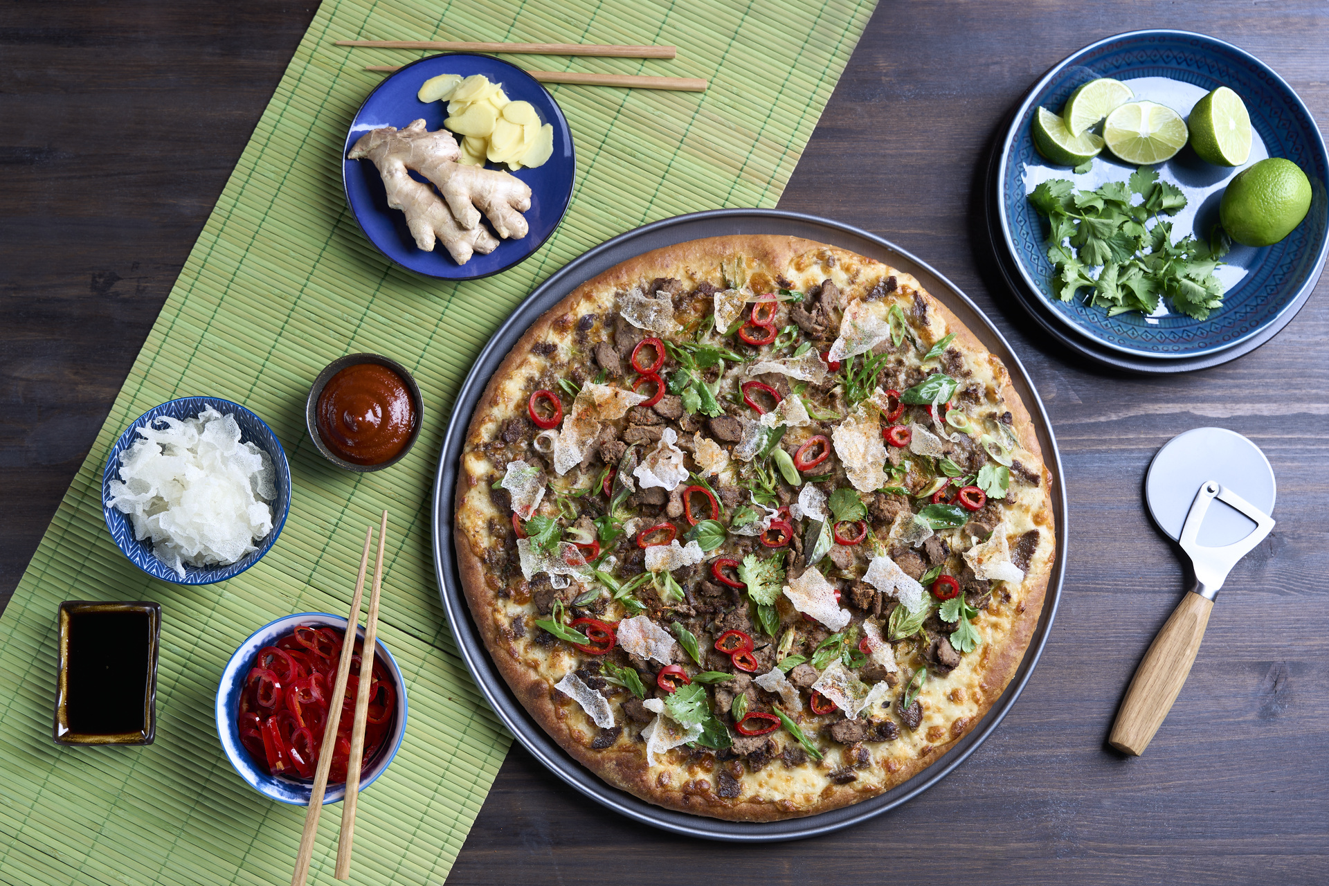
Ultimate Pizza & Bone-In Wings Promo
Any 90 Day period with a start date with in the next 60 days Starting May 4th
Promo Dates
Customers | Distributors | Operators
Business Group | Prepared | Prepared | Poultry
Discount Offer | Independent Distributor: The discount rate only applies to the product codes specified in this promotion during the promotional period. | Operator: Perpetuity - Discount is off Price list, and total price correlates with the price list changes. The discount rates only apply to the products specified in this promotion during the promotional period. Must coordinate with Revenue Growth Partner. | Operator: Perpetuity - Discount is off Price list, and total price correlates with the price list changes. The discount rates only apply to the products specified in this promotion during the promotional period. Must coordinate with Revenue Growth Partner.
Eligibility | Products not purchased within the last six months, direct shipments only. | Any new operator volume. | Any new operator volume.
Payment Method | Preferred method is Off Invoice. Billback is an option. | Discount will be set up on individual operator pricing deals. | Discount will be set up on individual operator pricing deals.
Approved Discount Rates | Bacon Toppings: $1.00/lb Pepperoni, Salami, Fully Cooked Philly: $.65/lb Crumbles: $.50/lb | Bacon Toppings: $1.00/lb Pepperoni, Salami, Fully Cooked Philly: $.65/lb Crumbles: $.50/lb | Bone-In Wings: Tyson®: $.30/lb Tyson Red Label®: $.08/lb
©2025 Tyson Foods, Inc. Trademarks and registered trademarks are owned by Tyson Foods, Inc. or its subsidiaries, or used under license.

Slide 2
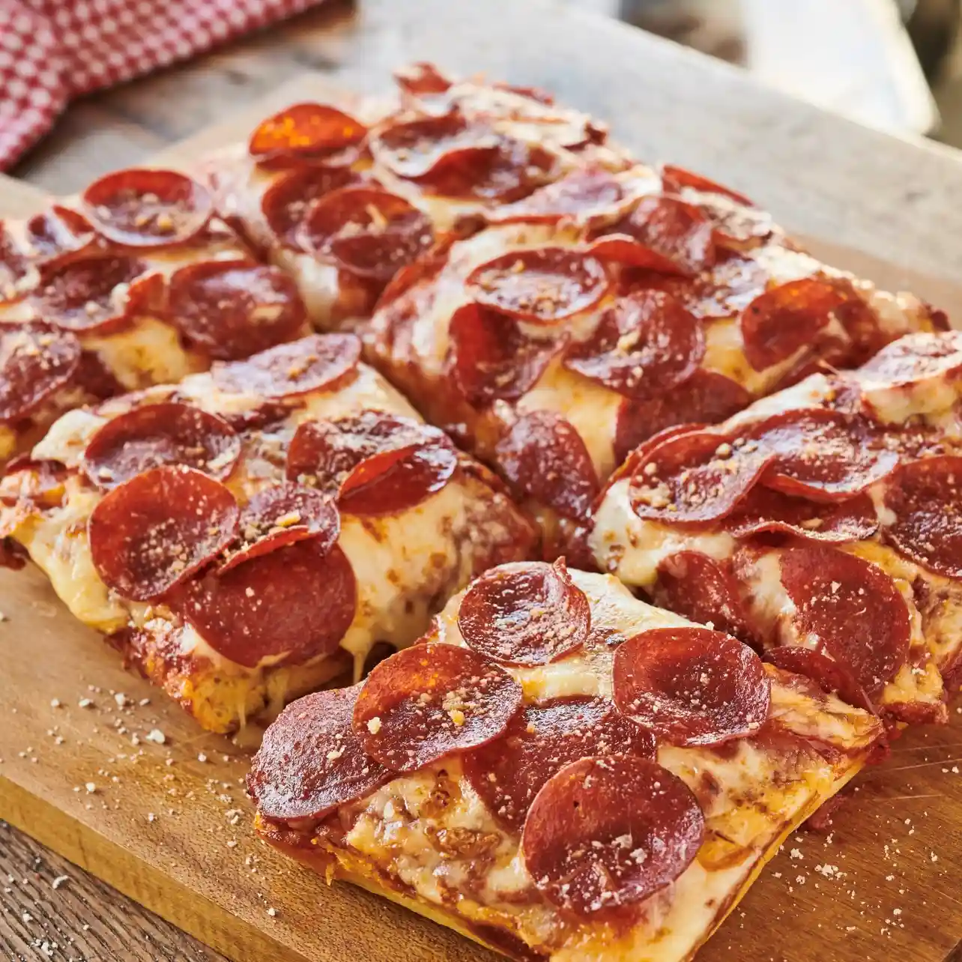
Ultimate Pizza & Bone-In Wings Promo
Operator
Any 90 Day period with a start date with in the next 60 days starting May 4th
Operator Terms & Conditions:
Operators are eligible to participate in the promotion. The discount rates are valid from April 27, 2025, to July 26, 2025, but once applied are good in perpetuity, and applies only to the product codes specified in this promotion. The discount is off price list and total price correlates with price list changes. The rates are valid during the promotion period. Prepared Discount Rates: Bacon Toppings: $1.00/lb Pepperoni, Salami, and Fully Cooked Philly: $.65/lb Crumbles: $.50/lb Poultry Discount Rates: Bone-In Wings: Tyson® $.30/lb Tyson Red Label® $.08/lb Payment will be based on a fixed price and connected with the Tyson Foods Price List. Participation requires confirming the products with Prepared or Poultry RevMan Partner.

Slide 3
Ultimate Pizza & Bone-In Wings Promo
Operator
Any 90 Day period with a start date with in the next 60 days starting May 4th
Bacon Toppings
Product Number | Product Description | Case Net Weight (lb) | Discount Rate/ lb
10000043794 | Jimmy Dean® Fully Cooked Bacon Pieces 1/4" | 10 | $1.00
10000043793 | Jimmy Dean® Fully Cooked Hardwood Smoked 1/4" Bacon Pieces | 10 | $1.00
10000043802 | Jimmy Dean® Fully Cooked Hardwood Smoked 3/8" Bacon Pieces | 10 | $1.00
10000043800 | Jimmy Dean® Fully Cooked Bacon Pieces 1/2" | 10 | $1.00
10000043804 | Jimmy Dean® Fully Cooked Hardwood Smoked 1/2" Bacon Pieces | 10 | $1.00
10000043797 | Jimmy Dean® Fully Cooked Hardwood Smoked 5/8" Bacon Pieces | 10 | $1.00
10000044037 | Jimmy Dean® Fully Cooked Hardwood Smoked Regular Cooked Bacon Pieces | 10 | $1.00
10000044019 | Jimmy Dean® Fully Cooked Hardwood Smoked Regular Cooked Bacon Pieces | 10 | $1.00
10000044038 | Jimmy Dean® Fully Cooked Bacon Pieces | 10 | $1.00
10240300269 | Hillshire Farm® Bakin' Bacon™ Heat-N-Serve Pizza Topping, 1/2 Inch x 1/2 Inch Diced | 10 | $1.00
Pepperoni, Salami, Fully Cooked Philly
Product Number | Product Description | Case Net Weight (lb) | Discount Rate/ lb
10000039352 | Hillshire Farm® Sliced Pepperoni | 25 | $0.65
10050140269 | Hillshire Farm® Sliced Pepperoni, 14 slices per oz. | 10 | $0.65
10157320393 | Hillshire Farm® Sliced Pepperoni, 14 slices per oz. | 25 | $0.65
10157330393 | Hillshire Farm® Sliced Pepperoni, 14 slices per oz. | 10 | $0.65
11042320389 | Hillshire Farm® Sliced Pepperoni, 12 slices per oz. | 25 | $0.65
11050050269 | Hillshire Farm® Sliced Pepperoni, 14 slices per oz. | 10 | $0.65
11050170269 | Hillshire Farm® Sliced Pepperoni, 14 oz. | 25 | $0.65
10000037705 | Hillshire Farm® Cupping Pepperoni | 10 | $0.65
10000060171 | Hillshire Farm® Cupping Pepperoni, 20 slices per oz. | 25 | $0.65
11042160269 | Hillshire Farm® Sliced Sandwich Style Pepperoni, 8 oz. | 10 | $0.65
10212010269 | Hillshire Farm® Sliced Pepperoni made with Chicken and Beef | 25 | $0.65
10587030465 | Hillshire Farm® Sliced Pepperoni, Chicken Added, 14 Slices per oz. | 25 | $0.65
10000012348 | Hillshire Farm® Pork, Italian Dry Salami, Sliced | 16 | $0.65
10000065158 | Hillshire Farm® Sliced Hard Salami | 10 | $0.65
10044410654 | Hillshire Farm® Genoa Salami | 10 | $0.65
11044450654 | Hillshire Farm® Sliced Hard Salami | 10 | $0.65
10000059945 | Original Philly® Fully Cooked Sliced Beef Steak, 4/2.5 LB | 10 | $0.65
10000059969 | Philadelphia Pre-Cooked Steak Co.™ Cooked Chicken Slices Caramel Color Added | 10 | $0.65

Slide 4
Ultimate Pizza & Bone-In Wings Promo
Operator
Any 90 Day period with a start date with in the next 60 days starting May 4th
 | Crumbles
 | Product Number |  |  | Product Description | Case Net Weight (lb) | Discount Rate/ lb
 | 10000041301 |  |  | Hillshire Farm® All Natural* Fully Cooked Pork Chorizo Crumbles | 10 | $0.50
 | 10000053728 |  |  | Hillshire Farm® All Natural Cooked Italian Sausage | 10 | $0.50
 | 10000053729 |  |  | Hillshire Farm® All Natural* Cooked Spicy Italian Sausage Crumbles | 10 | $0.50
 | 10015480393 |  |  | Hillshire Farm® Cooked Italian-Style Pork Topping | 10 | $0.50
 | 10015550393 |  |  | Hillshire Farm® Cooked Pork Topping | 10 | $0.50
 | 10015620269 |  |  | Hillshire Farm® All Natural* Italian Sausage, Large Chunk, Fully Cooked, 14 Pieces/oz. | 10 | $0.50
 | 10015750393 |  |  | Hillshire Farm® Cooked Pork Pizza Topping, Large Chunk | 10 | $0.50
 | 10015930393 |  |  | Hillshire Farm® Cooked Italian Style Pork Topping | 10 | $0.50
 | 10025460393 |  |  | Hillshire Farm® Cooked Beef Topping | 10 | $0.50
 | 10040640414 |  |  | Hillshire Farm® All Natural*, Sauté Style Pork Crumbles | 10 | $0.50
 | 10156930465 |  |  | Hillshire Farm® Cooked Pizza Topping | 10 | $0.50
 | 11011110465 |  |  | Hillshire Farm® Cooked Pizza Topping, Made with Pork and Chicken | 40 | $0.50
 | 11014750269 |  |  | Hillshire Farm® All Natural* Cooked Italian Sausage, Small Chunk | 10 | $0.50
 | 11015810269 |  |  | Hillshire Farm® Italian-Style Sausage, Fully Cooked | 10 | $0.50
 | 11018160269 |  |  | Hillshire Farm® Old World Specialties® Cooked Sausage with Italian Style Seasonings | 10 | $0.50
 | 11018170269 |  |  | Hillshire Farm® Old World Specialties® Spicy Italian-Style Sausage, Large Chunk | 10 | $0.50
 | 11025440393 |  |  | Hillshire Farm® Old World Specialties® Cooked Beef Topping | 10 | $0.50
 | 11025450465 |  |  | Hillshire Farm® Cooked Pizza Topping | 40 | $0.50
 | 11025620269 |  |  | Hillshire Farm® Cooked Beef Topping, Regular Chunk | 10 | $0.50
 | 11025750393 |  |  | Hillshire Farm® Cooked Beef Topping | 10 | $0.50
*Minimally processed. No artificial ingredients.
Bone-In Wings
Product Number | Product Description | Case Net Weight (lb) | Discount Rate/lb
Fully Cooked Bone-In Wings
10026380928 | Tyson® Fast Finish® Fully Cooked Coated Bone-In Chicken Wing Sections, Jumbo | 10 | $0.30
10045320928 | Tyson® W.W. Flyers® Fully Cooked Breaded Bone-In Chicken Wing Sections, Jumbo | 15 | $0.30
10045630928 | Tyson® Honey Stung® Fully Cooked Lightly Breaded Bone-In Chicken Wing Sections, Jumbo | 15 | $0.30
10052550928 | Tyson® Wings of Fire® Fully Cooked Glazed Bone-In Chicken Wing Sections, Jumbo | 10 | $0.30
10054840928 | Tyson® Fully Cooked BBQ Glazed Bone-In Chicken Wing Sections, Jumbo | 10 | $0.30
10128920928 | Tyson® Fire Stingers® Fully Cooked Breaded Bone-In Chicken Wing Sections, Jumbo | 15 | $0.30
10128930928 | Tyson® Wing Stingers® Fully Cooked Breaded Bone-In Chicken Wing Sections, Jumbo | 15 | $0.30
10135390928 | Tyson® Fully Cooked Oven Roasted Bone-In Chicken Wing Sections, Jumbo | 15 | $0.30
10135410928 | Tyson® Wings of Fire® Fully Cooked Glazed Bone-In Chicken Wing Sections, Jumbo | 10 | $0.30
10000061165 | Tyson Red Label® Fully Cooked Breaded Authentically Crispy Original Bone-In Chicken Wing Sections, Smedium | 15 | $0.08
10000063202 | Tyson Red Label® Fully Cooked Breaded Authentically Crispy Spicy Bone-In Chicken Wing Sections, Smedium | 15 | $0.08
10383170928 | Tyson Red Label® Fully Cooked Unbreaded Applewood Smoked Bone-In Chicken Wing Sections, Jumbo | 15 | $0.08
10383180928 | Tyson Red Label® Fully Cooked Coated Oven Roasted Bone-In Chicken Wing Sections, Jumbo | 15 | $0.08
Uncooked Bone-In Wings
10091490928 | Tyson® Uncooked Bone-In Chicken Wing Sections, Large | 30 | $0.30
10132610928 | Tyson® Magnum® IF Bone-In Chicken Wing Sections, Jumbo | 40 | $0.30
10161020928 | Tyson® IF Coated Bone-In Chicken Wing Sections, Jumbo | 20 | $0.30
10175310928 | Tyson® IF Coated Bone-In Chicken Wing Sections, With Salt and Vinegar Seasoning Packets, Jumbo | 20.62 | $0.30
©2025 Tyson Foods, Inc. Trademarks and registered trademarks are owned by Tyson Foods, Inc. or its subsidiaries, or used under license.

